Slide 1
Linux Gateway
Jacob Sherman

Slide 2
Goal
Main Goal
The goal of this project was to develop a WSN or embedded application to measure temperature
Objectives
Show understanding of the Beaglebone Black and the CC1350.
This goal was achieved by interfacing a Beaglebone Black with a pair of CC1350’s and measuring temperature on one and transmitting this information back through the other CC1350 to the Beaglebone.

Slide 3
Outcome - Accomplishments
Outcome – result of your project?
The CC1350 sensor Launchpad measures the temperature which is what I set out to do. The MAC-CoP launchpad then interfaces with the Beaglebone Black to show my understanding of it.
The project probably isn’t very useful as I was unable to actually get it to work as the sensor and Mac-CoP constantly disconnect and it would only measure temperature. If I had gotten it to work I would have added more sensors.

Slide 4
Components Used in Design
List
1xBeaglebone Black
2xCC1350
3xUSB Cable
Ethernet Cable
FTDI Cable

Slide 5
Tools used in Design
Uniflash - http://www.ti.com/tool/UNIFLASH
TI 15.4-Stack Linux Gateway SDK - http://www.ti.com/tool/ti-15.4-stack-gateway-linux-sdk
Tera Term - https://ttssh2.osdn.jp/index.html.en
Win32DiskImager - https://sourceforge.net/projects/win32diskimager/

Slide 6
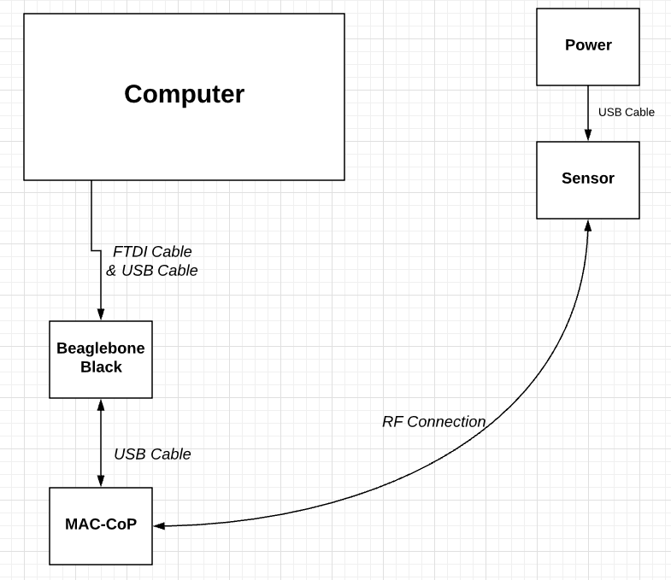
Schematics

Slide 7
Pre-requisites used in Design
Only need to install Linux Gateway SDK

Slide 8
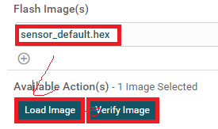

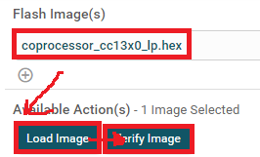
Implementation Details
Steps used in design:
STEP 1: Use uniflash to program the “sensor” launchpad.
STEP 2: Use uniflash to program the “MAC-CoP” launchpad.

Slide 9
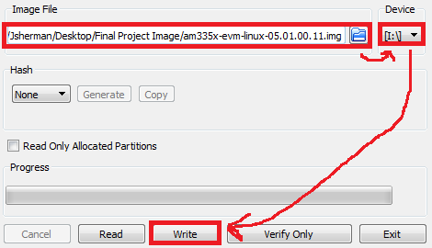
Implementation Details
STEP 3: Burn am335x-evm-linux-05.01.00.11.img to the SD card with Win32DiskImager.
STEP 4: Install Linux Gateway SDK to your computer

Slide 10
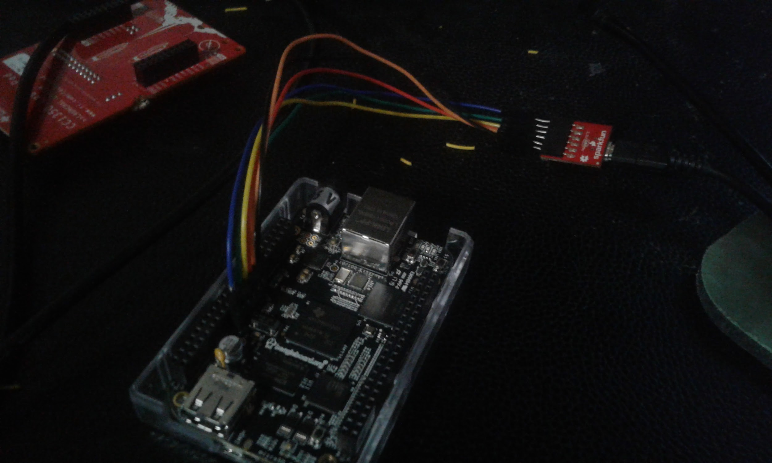
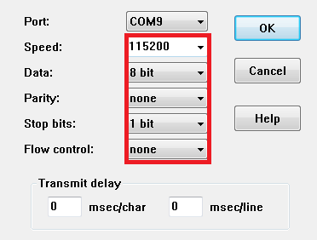
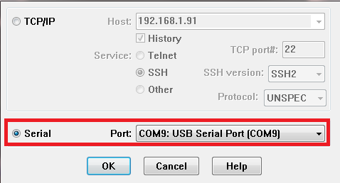
Implementation Details
STEP 5: Connect FTDI cable to Beaglebone Black and USB end to computer
STEP 6: Run Tera Term and connect it to the FTDI’s com port and set the baud rate to 115200, 8 data bits, no parity, 1 stop bit, no flow control

Slide 11
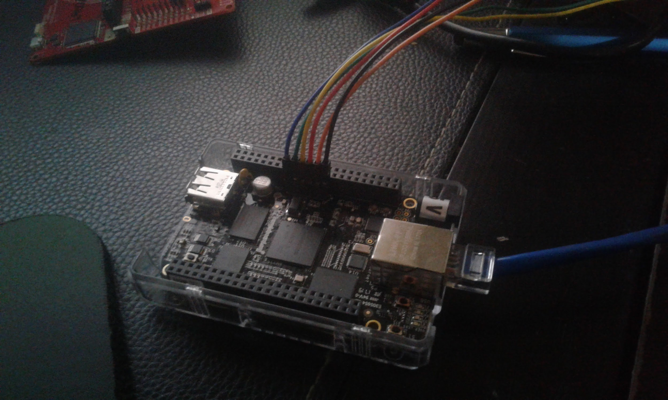
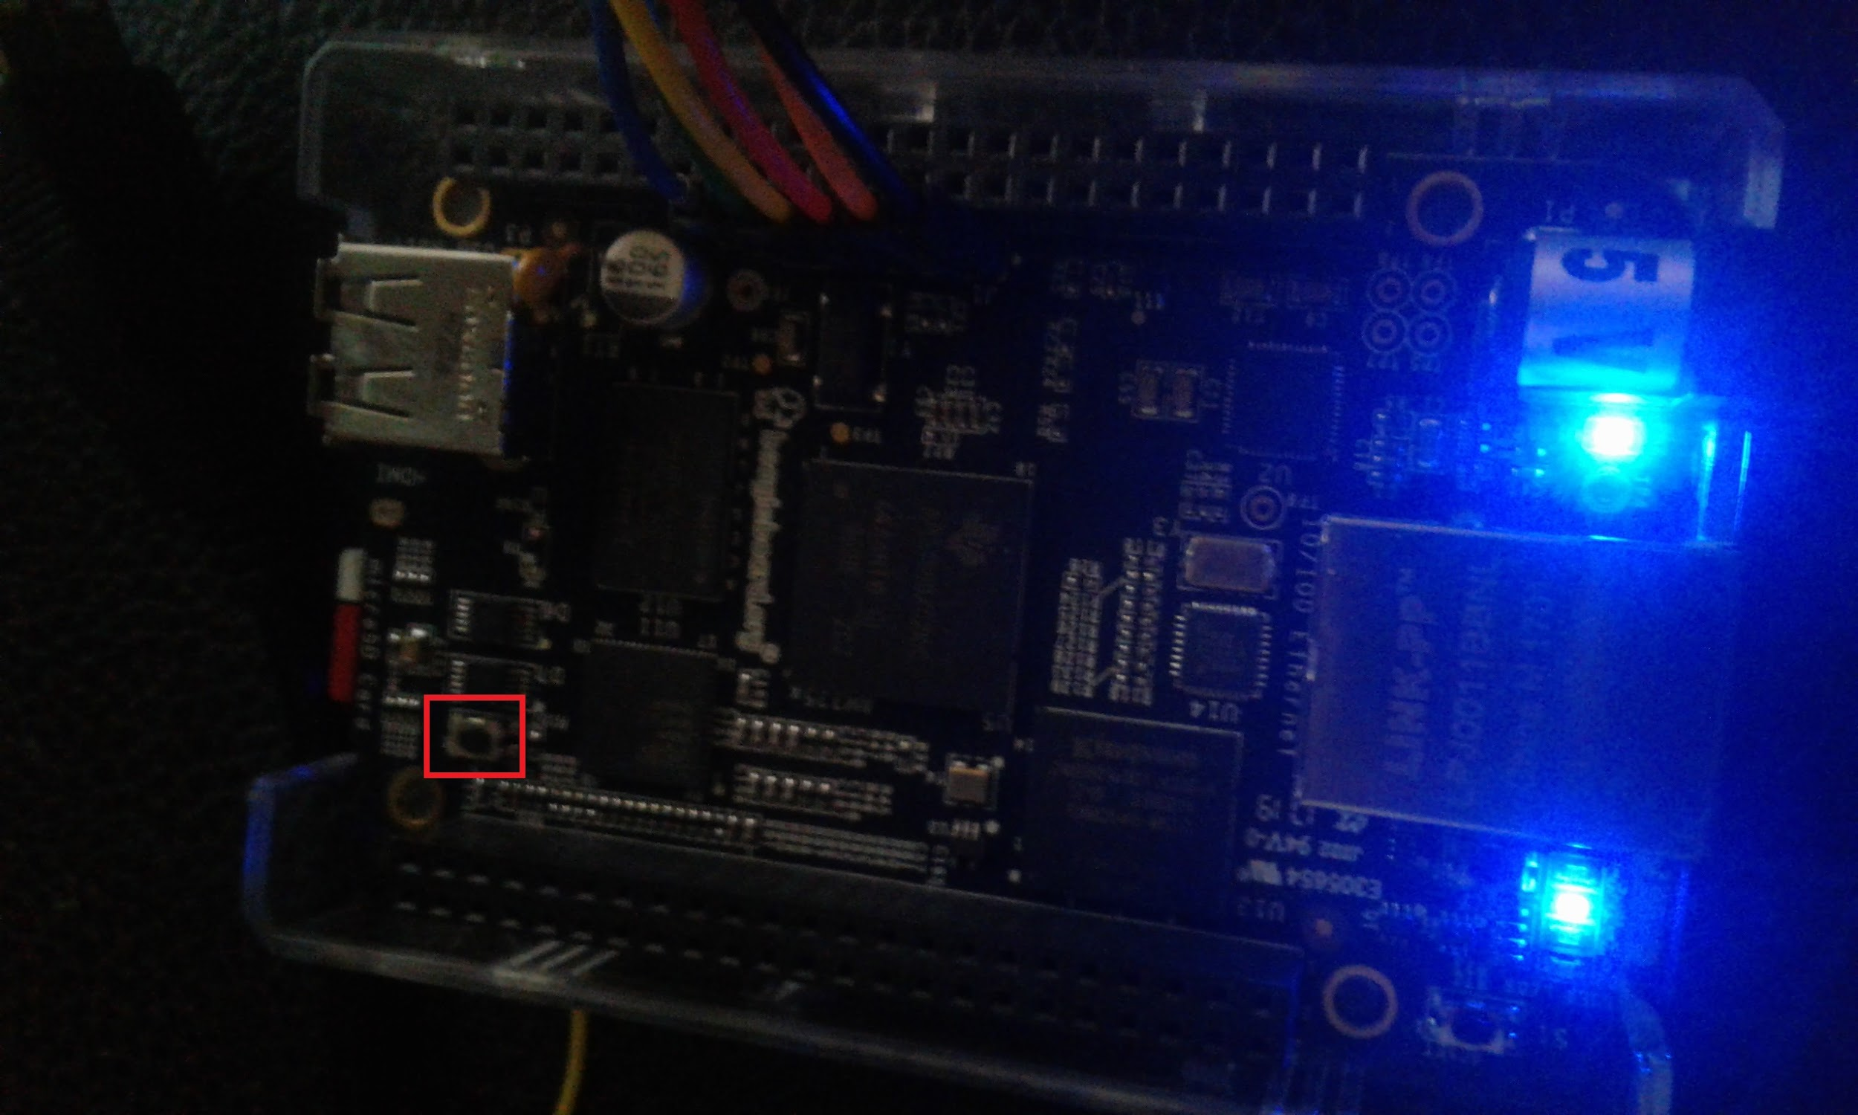
Implementation Details
STEP 7: Connect the ethernet cable and insert the SD card into the Beaglebone Black.
STEP 8: Press and hold the boot select button for a few seconds while supplying power to the Beaglebone Black then let go. In 5 to 10 seconds the LEDs should start flashing.

Slide 12
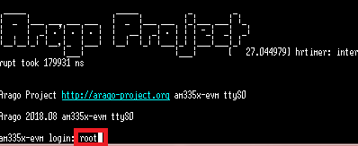
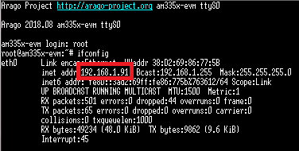
Implementation Details
STEP 9: Once the Beaglebone Black is up and running the terminal should show the Arago Project Welcome message. The username is root.
STEP 10: Use the ifconfig command to get the ip address of the Beaglebone Black. Then open another terminal to ssh to that ip address.

Slide 13
Implementation Details
STEP 11: Locate the bbb_prebuilt.tar.gz file in the Linux Gateway SDK. bbb_prebuilt.tar.gz should be in the prebuilt directory inside the main SDK folder which is by default installed to ~/ti/ti154stack_linux_x64_2_07_00_16/. Copy this file over to the Beaglebone Black. You can either use a flash drive or you can scp it through the network if the Beaglebone Black is connected to the same network as the computer you installed to.
Step 12: On the Beaglebone Black, extract bbb_prebuilt.tar.gz

Slide 14
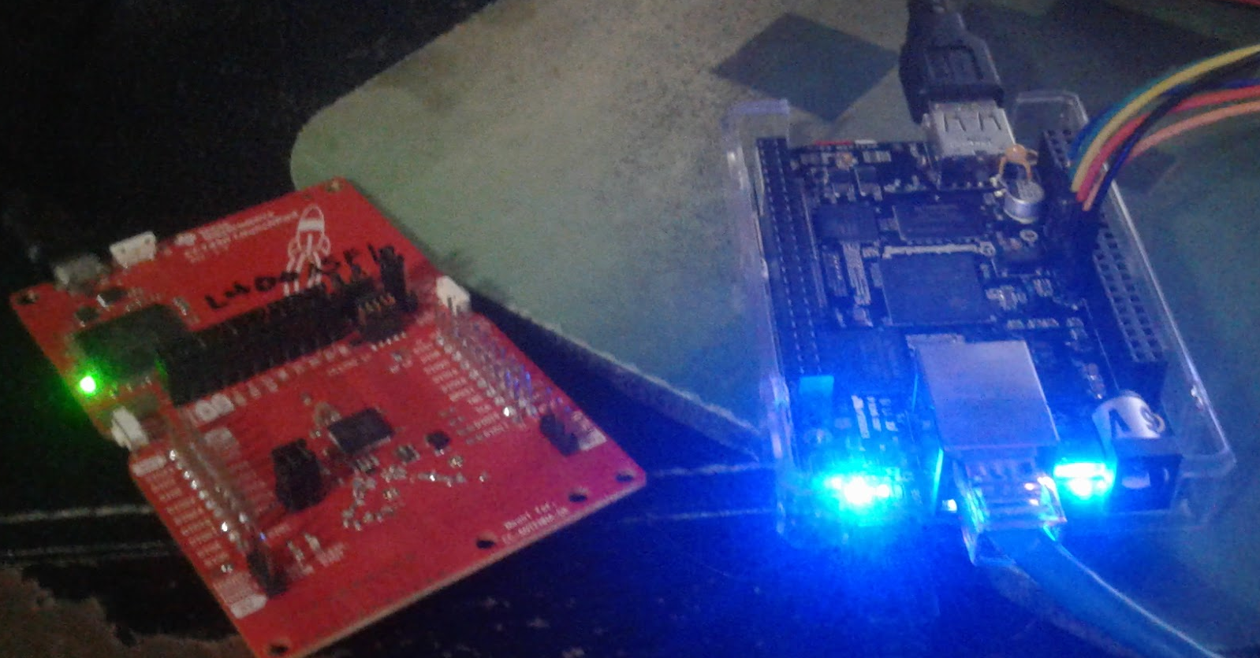
Implementation Details
STEP 13: Next connect the MAC-CoP Launchpad to the Beaglebone Black using a USB cable. After a few seconds you can check and see if the MAC-CoP connected properly by typing
ls -l /dev/ttyACM*
If it shows both /dev/ttyACM0 and /dev/ttyACM1 then it should be connected properly. If it shows a different number than you may need to change ttyACM0 to a different number in prebuilt/bin/collector.cfg

Slide 15

Implementation Details
STEP 14: So there is actually an error in the bash file used to start the application. This file is run_demo.sh It should be located in the prebuilt folder. You will need to edit it and change GATEWAY_DIR=${HERE}/gateway to GATEWAY_DIR=${HERE}/gateway/gateway. This is because when the bbb_prebuilt.tar.gz is extracted it extracts run_gateway.sh to prebuilt/gateway/gateway and not to prebuilt/gateway.

Slide 16
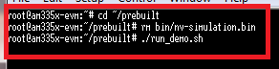
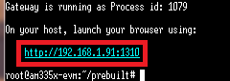
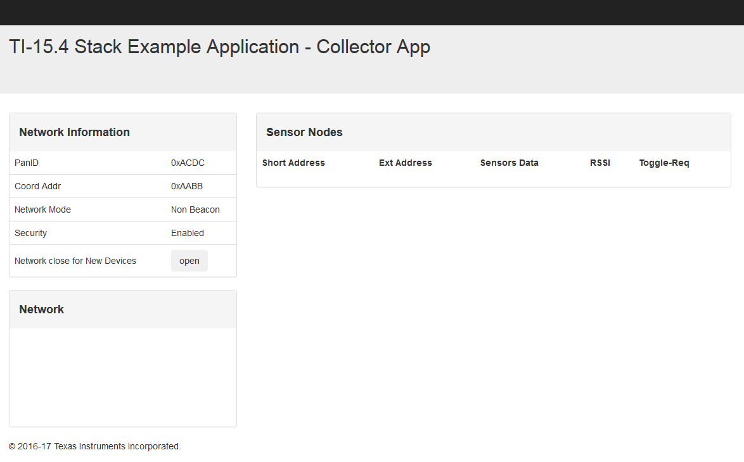
Implementation Details
STEP 15: Now with that error fixed you should be able to run the application by making sure you are in the prebuilt directory and using ./run_demo.sh. After typing that it should display on the terminal that it is running the application and some tasks. Eventually it will display the address of the collector app. It should be at http://<Beaglebone’s ip address>:1310 Copy the URL to your web browser and you should see the collector app.

Slide 17
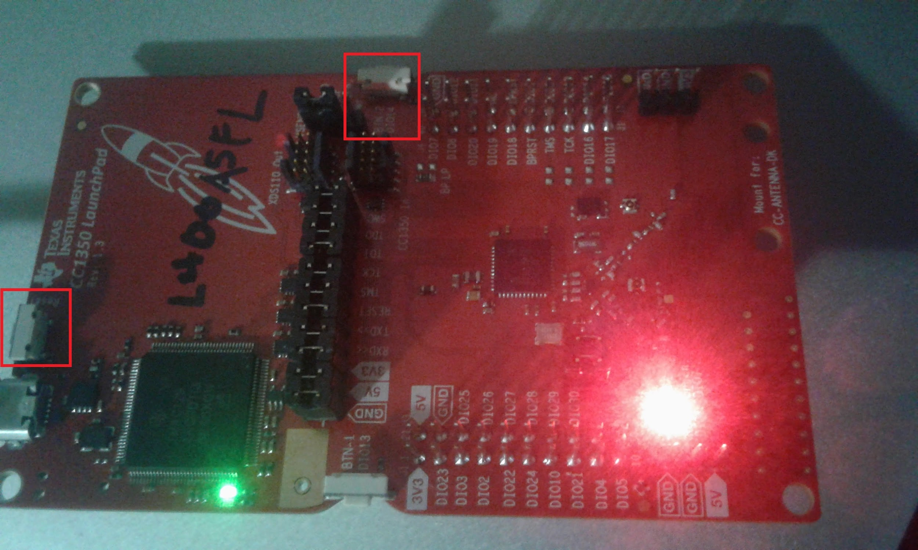
Implementation Details
STEP 16: Now connect the sensor launchboard to a power source using a USB and then reset it to factory default by pressing and holding button 2 and then pressing and releasing the reset button before releasing button 2.

Slide 18
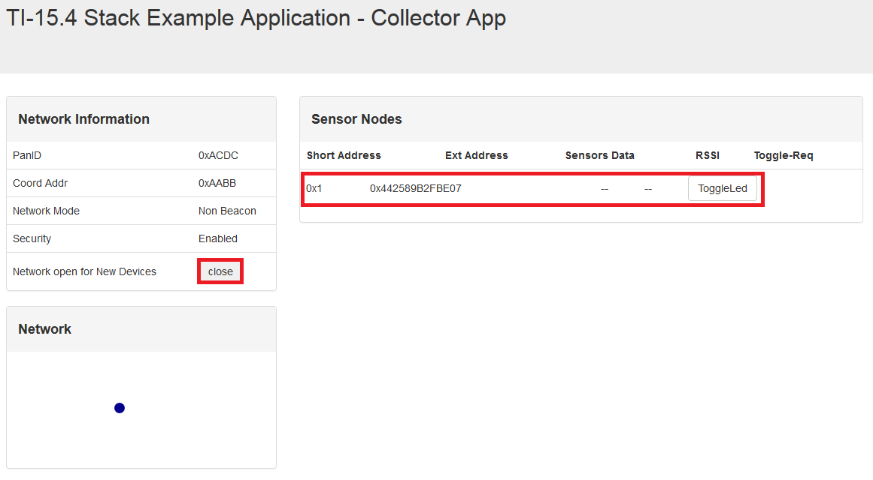
Implementation Details
STEP 17: Now press the open button on the collector app. Within a few seconds the sensor launchpad should connect and appear on the collector app. You can press LED toggle to turn the green LED on the Sensor on and off. It can sometimes have a few seconds of delay.

Slide 19
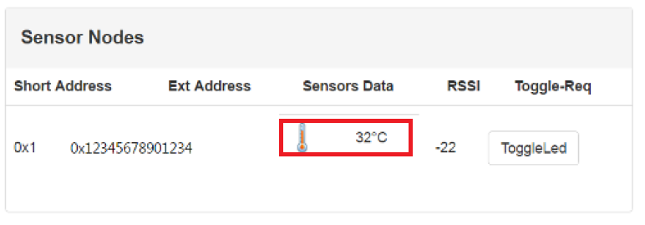
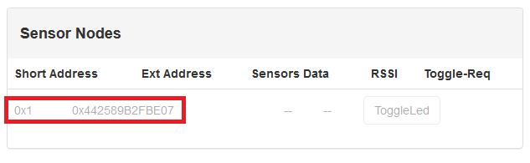
Implementation Details
STEP 18: Wait for temperature data to appear. For whatever reason in my tests they do not and the boards sometimes disconnect. I’m not sure the reason for this behavior.

Slide 20
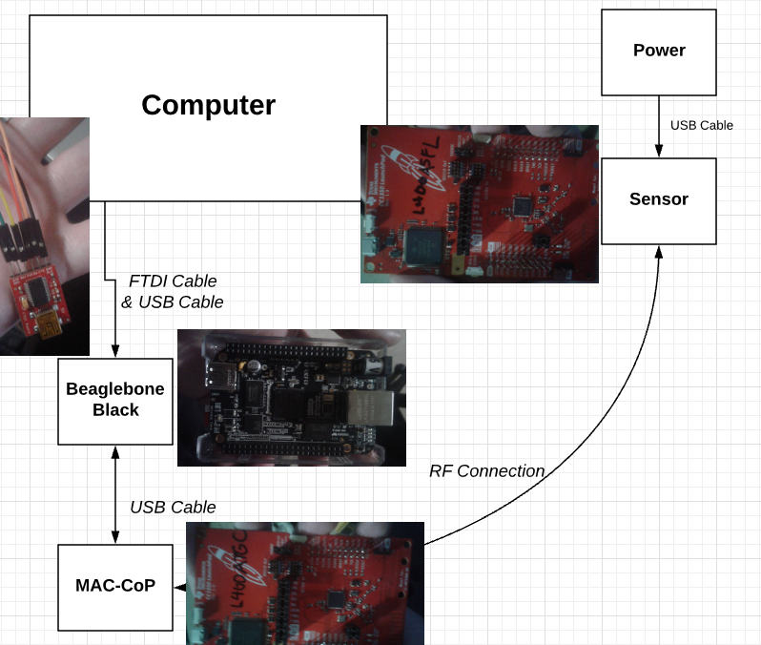
Actual project set-up

Slide 21
Demo
https://www.youtube.com/watch?v=CWfoMgZAt28&feature=youtu.be

Slide 22
Results and Conclusions
I failed to get any real results from my project. I couldn’t get any sensor data to appear in the collector app. As the sensor board would disconnect constantly.

